Slide 1


Hardening Windows Servers and Securing Active Directory
All resources are linked at the end of presentation
Unless stated assume tools mentioned are in a kali distro

Slide 2


Resources
ZTW/Resources at main · eoin-tl-ztw/ZTW (github.com)

Slide 3
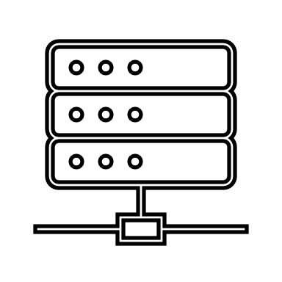
Windows Servers
Currently Supported
Windows Server 2022 – until 2031
Windows Server 2019 (version 1809) - until 2029
Windows Server 2016 (version 1607) - until 2027
Extended Support
Windows Server 2012 – until 2026
Windows Server 2008 – until 2024 in Azure – EOL on prem
That’s 15 years' worth of legacy and vulnerabilities out there, and that’s just the operating system

Slide 4
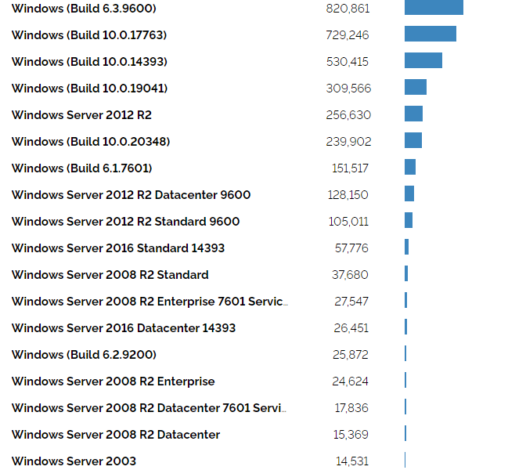
Windows Servers.... there is more
What about the distribution of currently unsupported OS versions?
The most recent published statistic I could find suggested 59% of observed instances were unsupported (09/2020 Rapid 7)
I decided to have a look myself... (shodan)
There is still a lot of legacy out there

Slide 5
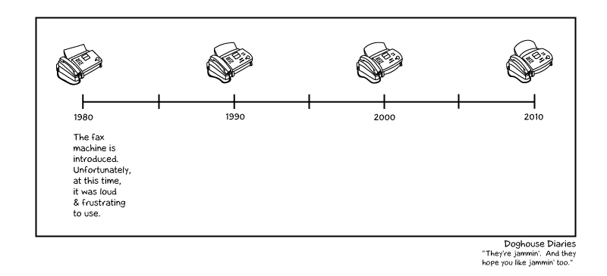
Reduce the Attack Surface
We can't just turn them off...
Update and Patch the Operating System where possible
Don't forget to update other software
Java, SQL, Exchange etc.
Disable things that aren't necessary
Services (Geolocation, Internet Sharing, Xbox Live :-D etc.)
User/Service Accounts
Fax

Slide 6
Reduce the Attack Surface Cont'd
Firewalls!
Intrusion Detection & Prevention
CIS Guidelines

Slide 7
To Sum up
Run Patched Software
Limit what Software can Execute
Use Dual-Factor Authentication
Block or Limit PowerShell
Ringfence Applications
Use as Little Software as Possible
Use a Server Firewall
Lock Down Folders per Application
Physically Secure Your Server or Use $Hidden Shares

Slide 8

Active Directory
What is AD– It's important to get back to first principals
It's Hierarchical, Domain based and Structured
It's Centralised for administration and security management
Authentication & Authorisation for Computers and users
It's a Directory Service for information and settings
User & Computer Accounts
Why are we doing this?
We need to prevent unauthorized access and breaches

Slide 9
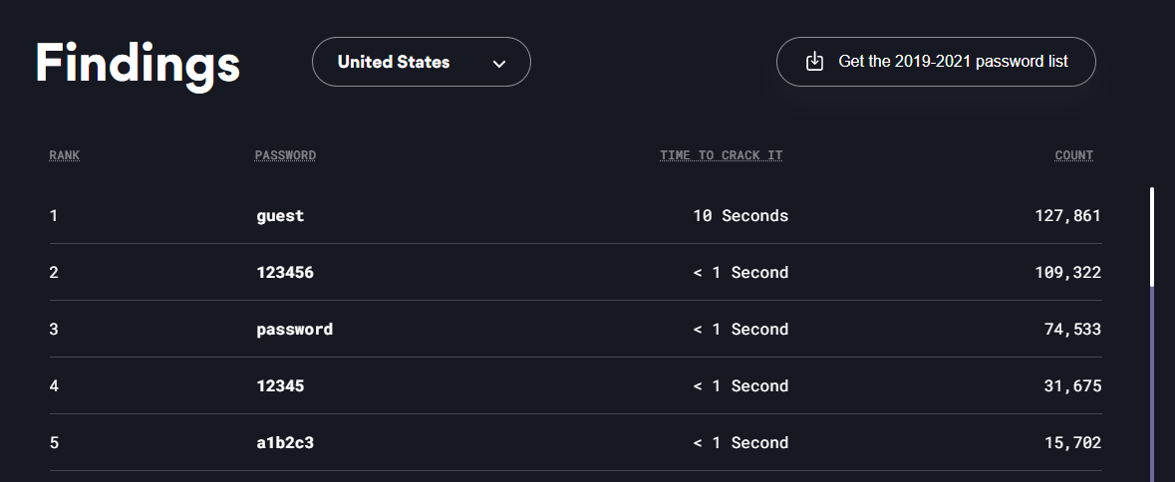
Let's Reduce Some Risks
Weak and Reused passwords
Do we still need to mention this one :-D
It is somewhat more relevant these days as more and more devices are open and connected to the net.
Enforce strong passwords. (nord)

Slide 10
Domain users with Local Administrator Privileges
It's a common mistake
Attacker won't initially have local admin rights, but will quickly discover any system that has Domain Users within the Local Admin Group
This misconfiguration lets an attacker move laterally and elevate from Domain User to Local Admin – they can now leverage and use this system to stage attacks
Principle of Least privilege - have a solution like Elevation Control that will elevate privileges on demand
Notes:
While the attacker might not have local admin rights on the system that provided the initial foothold, they will quickly try to discover misconfigurations and identify any networked systems that have included Domain Users within the Local Administrator Group. This misconfiguration allows the attacker to move laterally around the network and elevate from Domain User credentials to a Local Administrator
Never add Domain Users into the Local Administrator Group.

Slide 11
Some other easy wins!
Remove unused user accounts
Run a filter to see all user accounts that have not logged in for a long period of time, remove those accounts or disable them.
Get-ADComputer -filter * -Properties lastLogon | select DistinguishedName, @{N='LastLogon'; E={[DateTime]::FromFileTime($_.LastLogon)}}, Enabled
Remove Unused Computer Accounts
Get-ADComputer -filter * -Properties lastLogon | select DistinguishedName, @{N='LastLogon'; E={[DateTime]::FromFileTime($_.LastLogon)}}, Enabled
Notes:
While the attacker might not have local admin rights on the system that provided the initial foothold, they will quickly try to discover misconfigurations and identify any networked systems that have included Domain Users within the Local Administrator Group. This misconfiguration allows the attacker to move laterally around the network and elevate from Domain User credentials to a Local Administrator
Never add Domain Users into the Local Administrator Group.

Slide 12
Overuse of the Domain Admin Account
Let's use the domain admin for service accounts, remote access and scheduled tasks. It's easy!!
It's also a neat attack vector - on a compromised system, just wait for a domain admin to login
Attacker will change the WDigest value, then can come back and back again to check for a clear text password. Hello mimikatz!!
Firstly – stop doing this!
Application allowlisting – even if they succeed stop them from acting
Audit the registry, rotate passwords

Slide 13
More Admin tips
Rename Administrator Account
Administrator accounts are the most attacked accounts in active directory. Renaming them adds a simple barrier to stop attackers from trying to brute force the account. Rename it to something simple like a generic name. That is not a real person.
Creating a second admin account for logging onto user computers is not a domain admin.
e.g., eoinlocaladmin – This account will be a member of the local admin accounts on the computers but not a member of the domain admins. This means if a user has a keylogger on their computer, they will not be able to login the domain control and push out ransomware using group policy.
Notes:
While the attacker might not have local admin rights on the system that provided the initial foothold, they will quickly try to discover misconfigurations and identify any networked systems that have included Domain Users within the Local Administrator Group. This misconfiguration allows the attacker to move laterally around the network and elevate from Domain User credentials to a Local Administrator
Never add Domain Users into the Local Administrator Group.

Slide 14
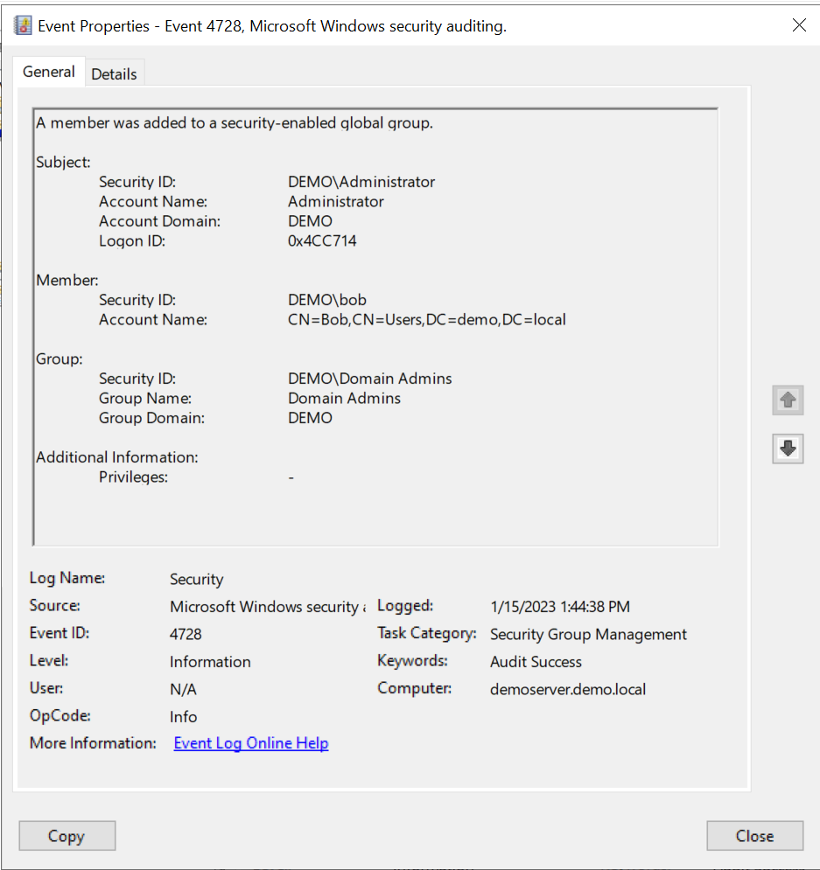
Monitor for Privileged Account Changes
Monitor for event ID 4728
Monitor for all events in the 47** range
This subcategory allows you to audit events generated by changes to security groups such as the following:
Security group is created, changed, or deleted.
Member is added or removed from a security group.
Group type is changed.
Top Tip
You can use ThreatLocker ThreatOps Policy for this!!
Notes:
While the attacker might not have local admin rights on the system that provided the initial foothold, they will quickly try to discover misconfigurations and identify any networked systems that have included Domain Users within the Local Administrator Group. This misconfiguration allows the attacker to move laterally around the network and elevate from Domain User credentials to a Local Administrator
Never add Domain Users into the Local Administrator Group.

Slide 15
Service Accounts: Overprivileged and Unmanaged
All privileged accounts will be targeted – naturally, service accounts are included
Accounts using Service Principal Name (SPN) when we access this service, we get a Kerberos ticket with a NTLM hash of the account
Using a technique called Kerbroasting, we can grab a script from GitHub (GetUserSPN.py) and use HashCat on the output to retrieve a password!
Strong passwords! Application Allowlisting! Reset the KDC service account – but remember to do it twice...

Slide 16
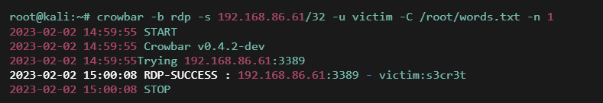
RDP: It's brutal out there!
If RDP is enabled, you can guarantee someone is using NMap or masscan to find it.
Next step – try to brute force some credentials using crowbar or a similar tool. This is particularly effective if passwords have been reused
Multi Factor Authentication is essential
Network Access Control
Audit everything

Slide 17
Protect Virtual Domain Controllers
VHDs can be copied, allowing attackers to view files, do brute force on password databases, and gain access to other parts of the system.
Use BIT Locker on your domain controllers. This will prevent viewing of VHDs without decryption keys.
Make sure your physical server is well protected (See server hardening) and has limited network access to it.
Limit Access to VHDs to only the Hyper-V service.

Slide 18
Active Directory Schema (AD AS)
Limit User Access with Enterprise Admins and Schema admin access
There is one default account with schema admin access. Very few programs need to change the active directory schema. Don’t create new schema admin accounts unless they are really required.
Deploy Schema Master in its own vlan, with only limited communication to other domain controllers.
The schema master is the only domain controller that can make changes to the schema. It is better to restrict it onto its own vlan or use endpoint firewall, so only other domain controllers can see it. This is relevant to bigger domains.

Slide 19
Some General Tips
Have a Windows Audit policy – check out the link in resources
Enable Dual Factor Authentication on your domain controllers.
Block internet access
Either through Ringfencing each app, and only allowing apps that need go the internet to go or blocking all on Firewall.
Why? SolarWinds Orion

Slide 20
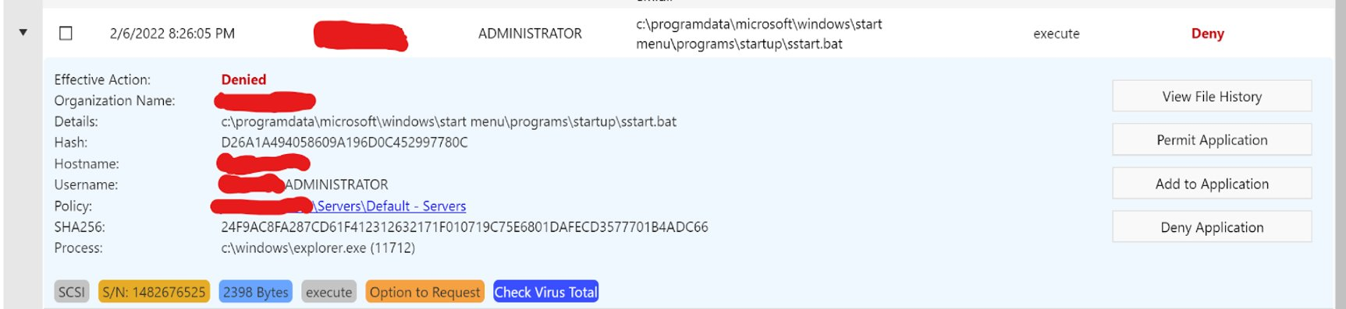
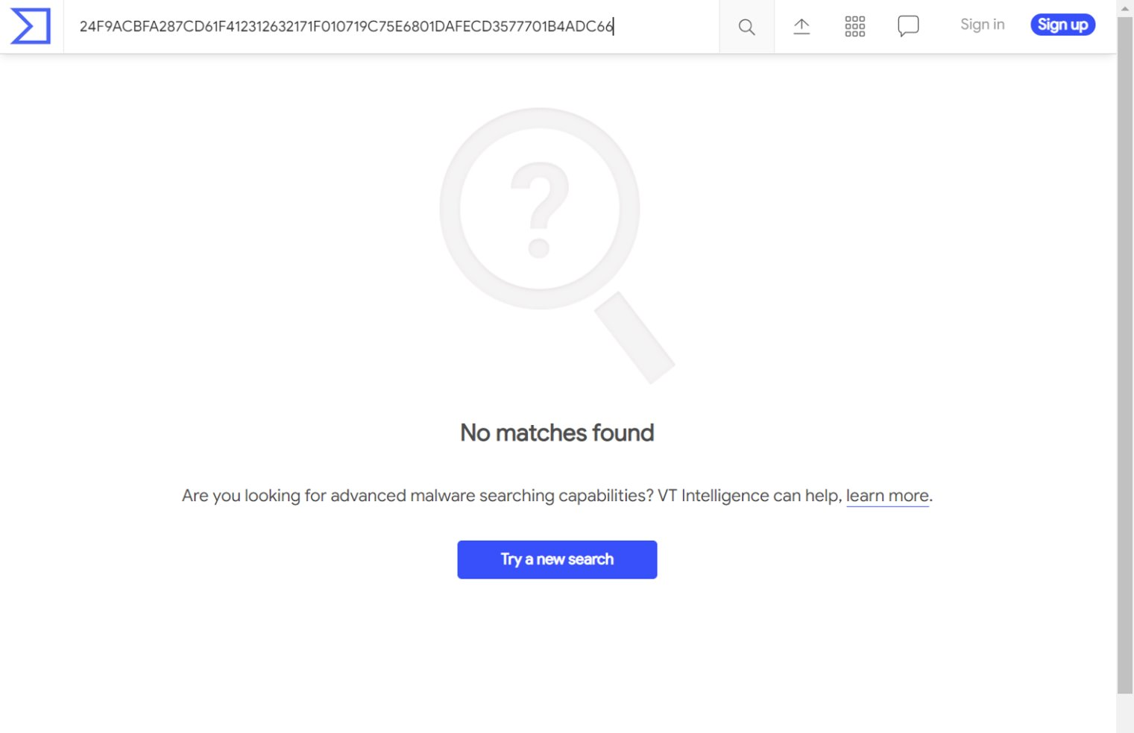
How Important is Allowlisting
Let's check this out...
Nothing is virus total either!

Slide 21
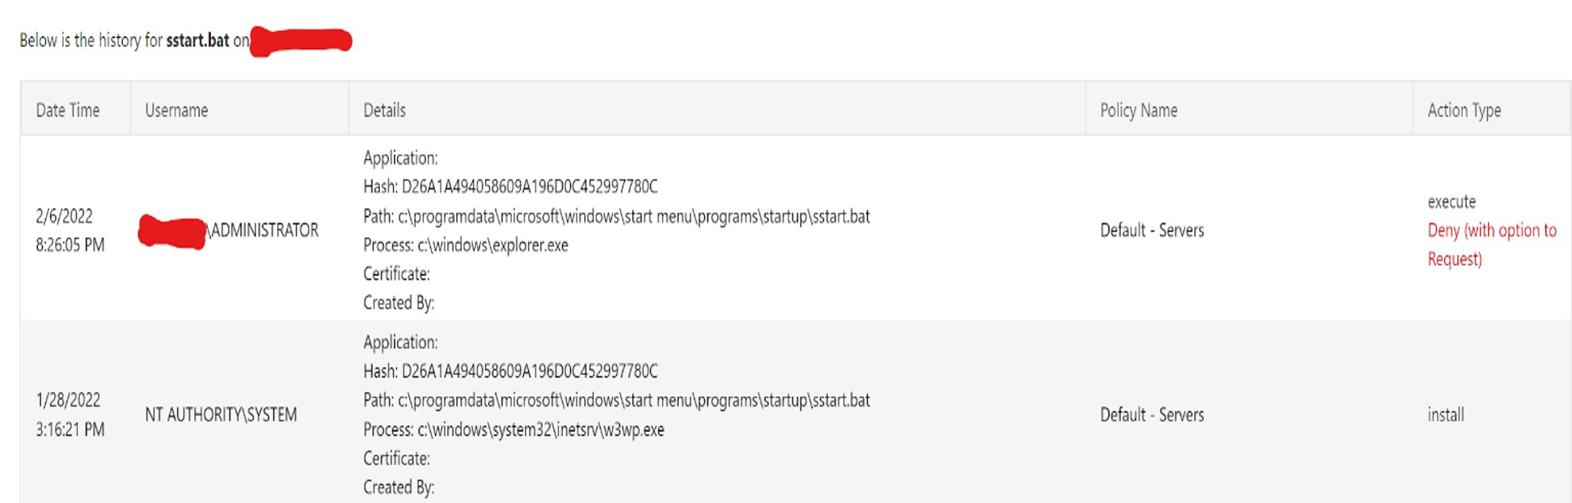
Why did IIS Create this
That’s a little concerning

Slide 22
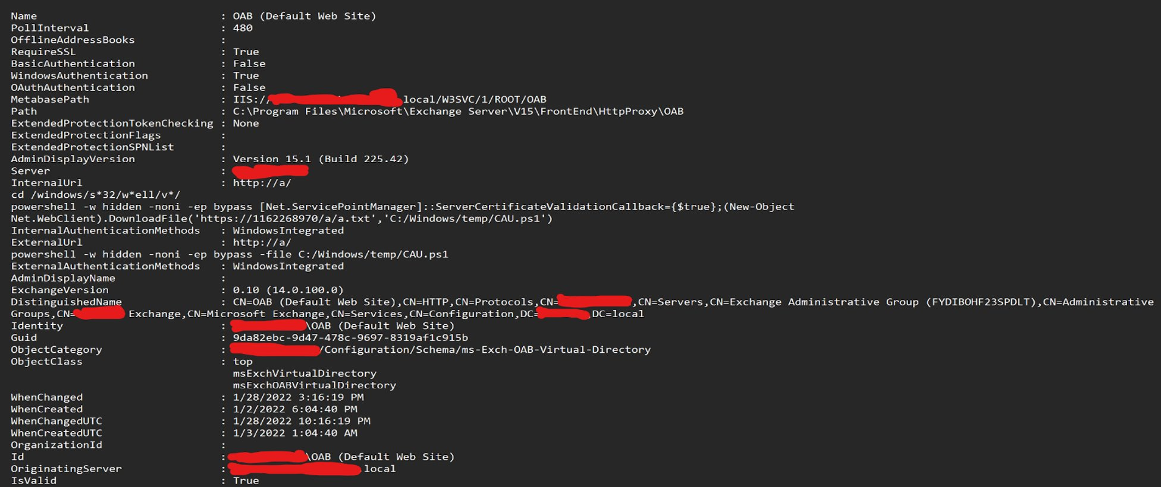
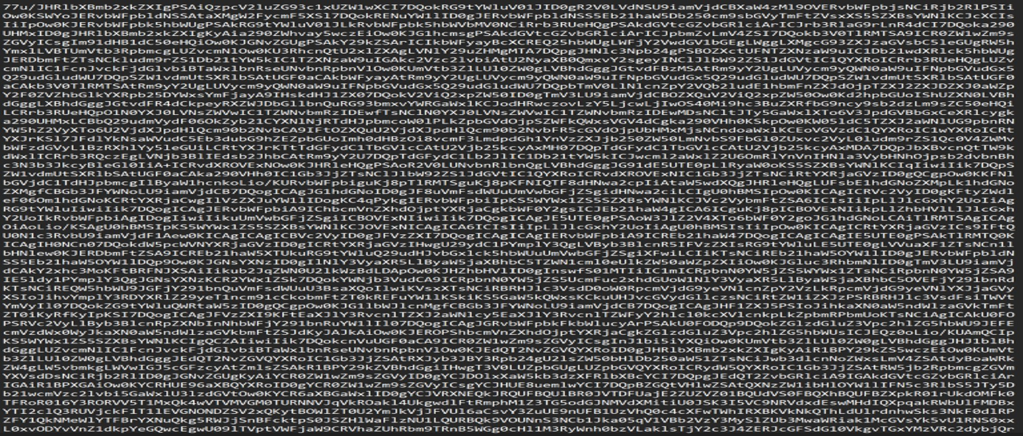
We reviewed the configuration on the server and found that the Exchange OAB configuration, was set with a URL to download malicious code…
Base64 encoded of course! for no other reason than to make it difficult to detect potential malicious lines.

Slide 23
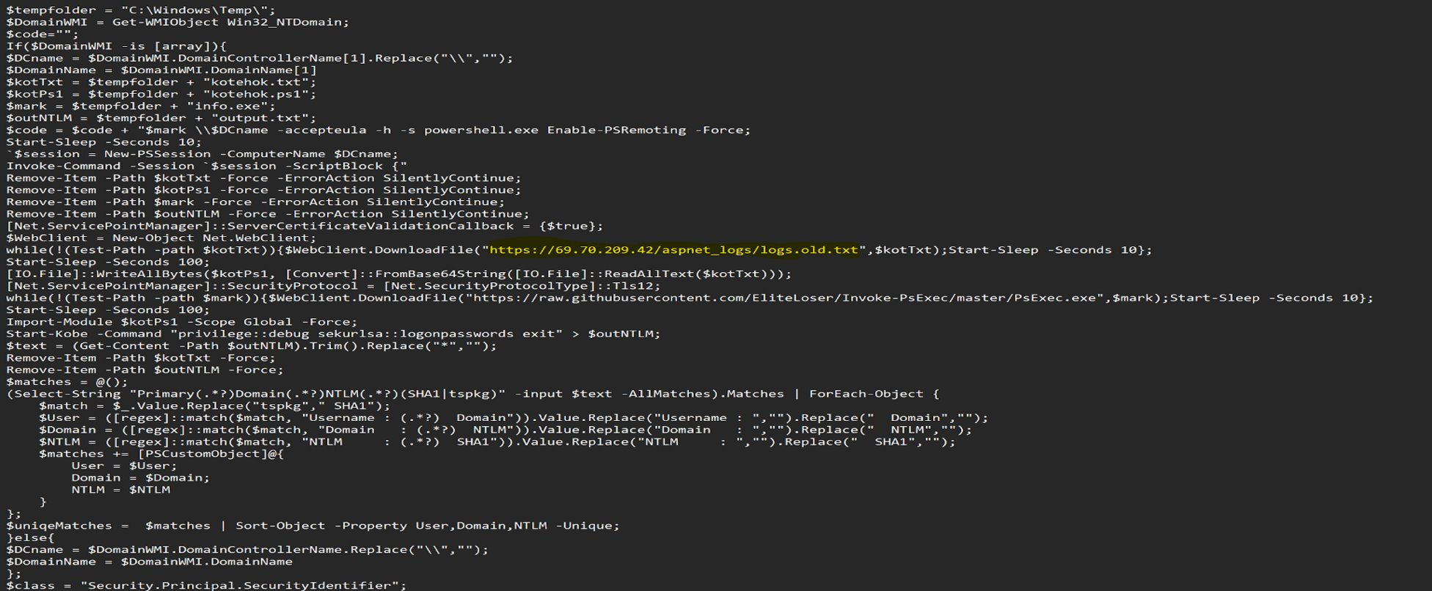
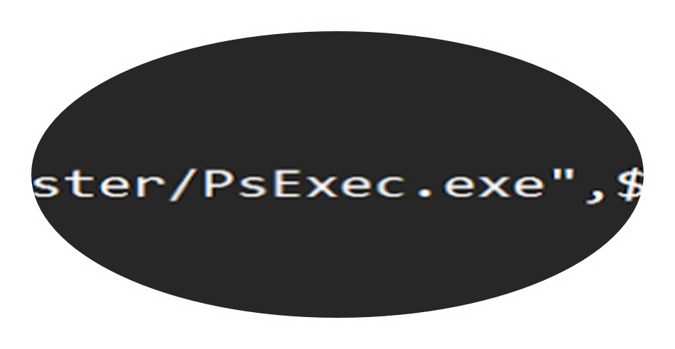
We decoded it, and it downloaded another malicious payload and psexec.exe… Which is a Microsoft component to run things at the system level.

Slide 24
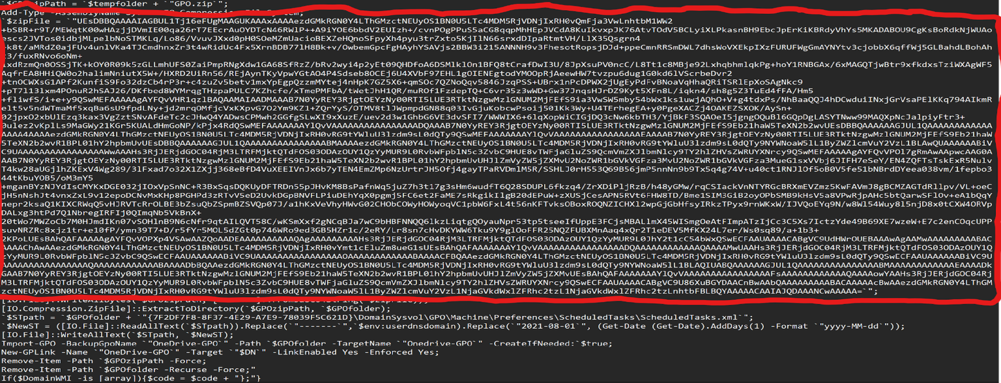
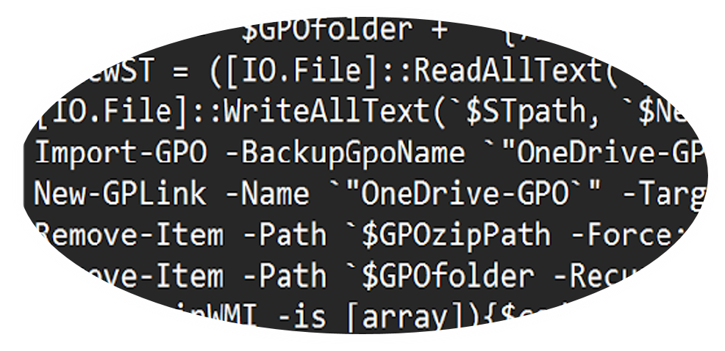
Created a GPO, to push out the ransomware to every computer in the domain, including servers, laptops, and workstations. Within 2 hours, everything was encrypted, and all data was uploaded to the internet.

Slide 25
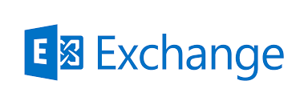
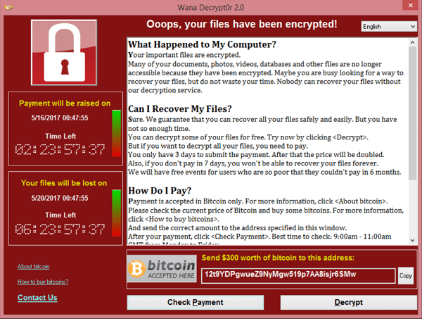
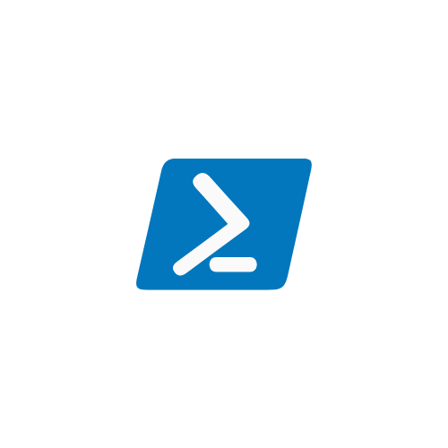
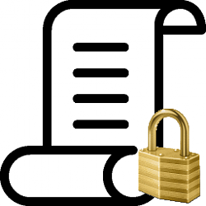
How Important is Allowlisting

Slide 26
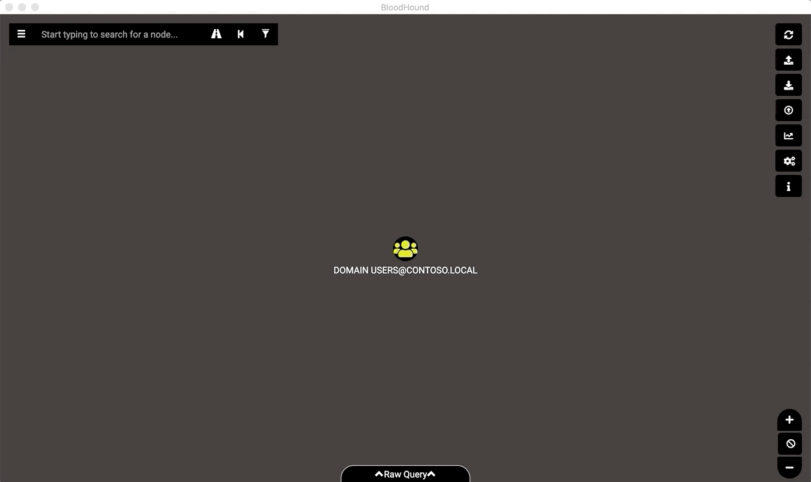
Graph Theory: It's not just social
There are some new cool tools out there
Bloodhound – uses graph theory to expose relationships in an AD environment. Making it easier to identify potential attack paths.
For a historical context check out the article in resources - it's amazing what the graph can tell us (wolfram)
Try using the tool..
Application allowlisting

Slide 27
Of course, I asked ChatGPT....
There are several steps you can take to harden Active Directory:
Use strong passwords and enforce password policies: Use long, complex passwords and enforce policies such as frequent password changes and disabling accounts after a certain number of failed login attempts.
Implement multi-factor authentication: Use multi-factor authentication to provide an additional layer of security beyond just a password.
Use Group Policy Objects (GPOs) to control access: Use GPOs to control access to sensitive data and resources.
Keep your operating system and software up-to-date: Regularly apply security updates and patches to your operating system and software to protect against known vulnerabilities.
Regularly monitor and review logs: Regularly monitor and review logs to identify and respond to suspicious activity.
Use a firewall: Use a firewall to protect your network from unauthorized access.
Regularly backup your data: Regularly backup your data to protect against data loss in case of a security incident.
Limit access: Limit access to sensitive data and resources to only those who need it.
Use security software: Utilize security software such as antivirus, anti-malware, and intrusion detection/prevention systems to protect against known threats.
Train employees: Train employees on security best practices and how to identify and respond to suspicious activity.
It's important to note that hardening AD is a continuous process, and you should periodically review and update your security measures.

Slide 28
Maybe I should have done that first!

Slide 29
Resources
ZTW/Resources at main · eoin-tl-ztw/ZTW (github.com)

Slide 30


